Slide 1
Interpretable Machine Learning
Dr. Johannes Oberreuter | Data Scientist

Slide 2
source: xkcd

Slide 4
Machine learning should do something beyond standard linear models but we still want to understand what is going on.

Slide 5
Let’s use Random Forests as proof of Concept
https://medium.com/usf-msds/intuitive-interpretation-of-random-forest-2238687cae45https://medium.com/usf-msds/intuitive-interpretation-of-random-forest-2238687cae45
The methods generalize to arbitrary ML algorithms
Including neural networks etc.

Slide 6
Feature Importance

Slide 7
Two possibilities
Mean decrease of…
Impurity:
Average decrease in Gini impurity/entropy/variance by each feature
Problems:
biased towards preferring variables with more categories
correlated features are ranked randomly

Slide 8
Two possibilities
Mean decrease of…
Accuracy:
Drop of accuracy after random shuffling of individual features
Problems:
measurements after training and depending on all features
correlated features can compensate
source: Prince Grover, medium

Slide 9
Two possibilities
Mean decrease of…
Accuracy:
Drop of accuracy after random shuffling of individual features
Problems:
measurements after training and depending on all features
correlated features can compensate
Impurity:
Average decrease in Gini impurity/entropy/variance by each feature
Problems:
biased towards preferring variables with more categories
correlated features are ranked randomly
Both ways, averaging over several runs should be used!

Slide 10
Confidence Intervals

Slide 11
Bias-Variance tradeoff
source: Prince Grover, medium

Slide 12
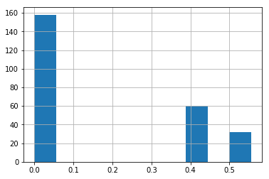
Loan Risk Dataset
Confidence Intervals

Slide 13
Justifying individual predictions

Slide 14
Tree interpreter
Path of individual occurrence through forest
source: Prince Grover, medium

Slide 15
Loan Risk Dataset
examPles

Slide 16
Relation of individual features with target

Slide 17
Partial dependence plots
Use all values of features
source: Prince Grover, medium

Slide 18
Loan Risk Dataset
Package: PDPbox
https://github.com/SauceCat/PDPbox

Slide 19
Loan Risk Dataset
Package: PDPbox
https://github.com/SauceCat/PDPbox

Slide 20
Loan Risk Dataset
Package: PDPbox
https://github.com/SauceCat/PDPbox

Slide 21
Loan Risk Dataset
Package: PDPbox
https://github.com/SauceCat/PDPbox

Slide 22
Loan Risk Dataset
Package: PDPbox
https://github.com/SauceCat/PDPbox

Slide 23
Loan Risk Dataset
Package: PDPbox
https://github.com/SauceCat/PDPbox

Slide 24
Loan Risk Dataset
Package: PDPbox
https://github.com/SauceCat/PDPbox

Slide 25
Problems of PDP plots
Generation of non-sensical data
source: Apley, D. W. (2016). Visualizing the Effects of Predictor Variables in Black Box Supervised Learning Models

Slide 26
Examples
PdP vs ALE plots for neural networks

Slide 27
SHapley Additive exPlanations (Shap)

Slide 28
Individual explanations
Shapley Values
A group of people are playing a game. As a result of playing this game, they receive a certain reward; how can they divide this reward between themselves in a way which reflects each of their contributions in a fair way?
The sum of what everyone receives = total reward
If two people contributed the same value, they receive the same amount
Someone who contributed no value should receive nothing
If the group plays two games, individual’s reward = their reward from their first game + their reward from the second game
Lundberg, S. M., Erion, G. G., & Lee, S.-I. (2018). Consistent Individualized Feature Attribution for Tree Ensembles. Retrieved from http://arxiv.org/abs/1802.03888

Slide 29
Shapley value
Compare With and without feature
source: Molnar, C. (2018). Interpretable Machine Learning.
Retrieved from https://christophm.github.io/interpretable-ml-book/

Slide 30
Shapley value
coalitions

Slide 31
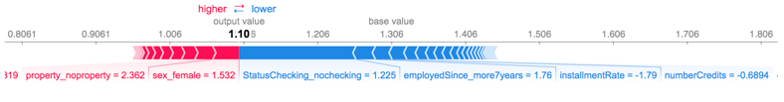
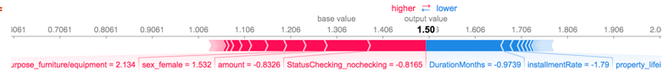
Loan Risk Dataset
Individual customers
Package: shap,
https://github.com/slundberg/shap

Slide 32
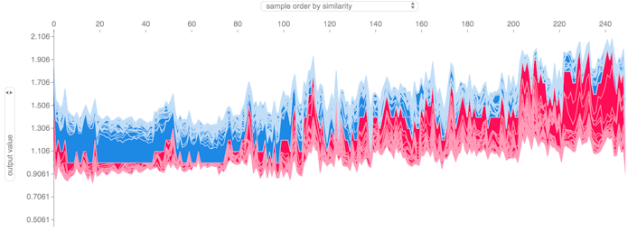
Loan Risk Dataset
Full Dataset
Package: shap,
https://github.com/slundberg/shap

Slide 33
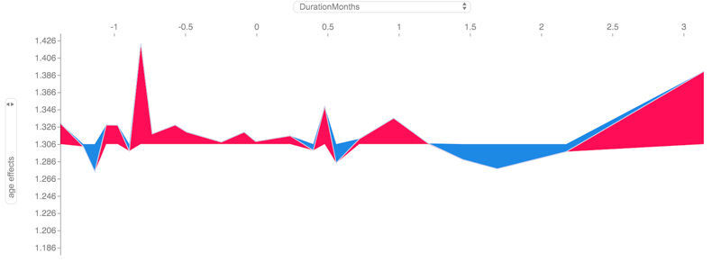
Loan Risk Dataset
Age effects over time
Package: shap,
https://github.com/slundberg/shap

Slide 34
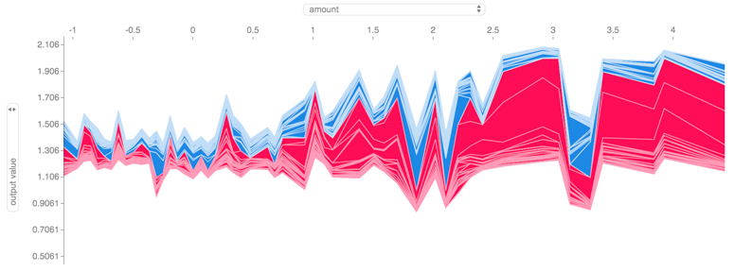
Loan Risk Dataset
Effects by amount
Package: shap,
https://github.com/slundberg/shap

Slide 35
Loan Risk Datset
Different VAlues

Slide 36
Shap for Deep Learning
Deep explainer
source: https://github.com/slundberg/shap

Slide 37
Shap for Deep Learning
Gradient Explainer
source: https://github.com/slundberg/shap

Slide 38
Local Surrogate Models (Lime)

Slide 39
Lime for tabular data
source: Molnar, C. (2018). Interpretable Machine Learning.
Retrieved from https://christophm.github.io/interpretable-ml-book/

Slide 40
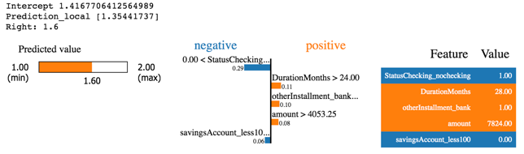
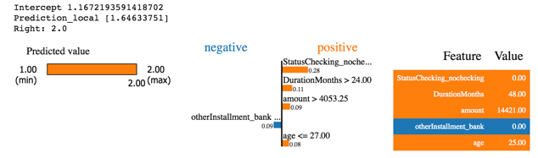
Loan Risk Datset
Different VAlues

Slide 41
Lime for Images
source: Molnar, C. (2018). Interpretable Machine Learning.
Retrieved from https://christophm.github.io/interpretable-ml-book/

Slide 42
source: xkcd

Slide 43
Thank you
www.reply.com

Slide 44



